Slide 1
ECG Classification & Report Platform
An advanced automated machine learning pipeline and clinical reporting platform for rapid, accurate electrocardiogram analysis and cardiac health diagnostics.

Slide 2

The Clinical Challenge
Why cardiovascular diagnostics urgently need modernization, speed, and precision.

Slide 3


The Diagnostic Bottleneck
Delayed Analysis & Backlogs
Complex Reporting Gaps
Cardiologists and emergency physicians face overwhelming volumes of ECG traces daily. Manual interpretation is time-consuming, leading to delayed diagnoses in acute cardiac events where every second counts.
Traditional diagnostic equipment outputs raw waveforms or fragmented readouts that lack standardized structuring, making patient history tracking, clinician collaboration, and secondary review difficult.

Slide 4
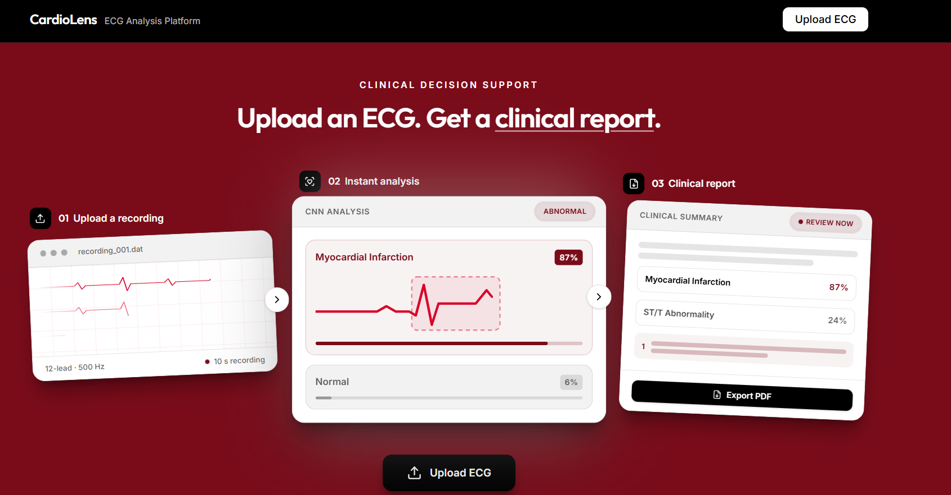

The Solution: Intelligent Platform
Automated Signal Processing: Instantly ingests, filters, and normalizes raw ECG readings to eliminate noise and artifacts.
ML-Powered Classification: A deep-learning SE-ResNet scores each recording across five diagnostic superclasses (NORM/MI/STTC/CD/HYP).
Structured PDF Reports: Auto-generates clean, professional diagnostic summary reports ready for physician sign-off.
Streamlined Workflow: Bridges the gap between raw signal capture and actionable clinical insights.

Slide 5
Technical Architecture
A robust backend processing pipeline meets a clean user interface.

Slide 6








System Components
1. Ingestion & Preprocessing
2. ML Classification Engine
3. Report Generation
Signal filtering, baseline wandering removal, and normalization of lead inputs for reliable inference.
A 1D SE-ResNet trained on PTB-XL scores each recording across five diagnostic superclasses.
Automated synthesis of diagnostic findings, confidence scores, and waveforms into clean clinical documents.

Slide 7
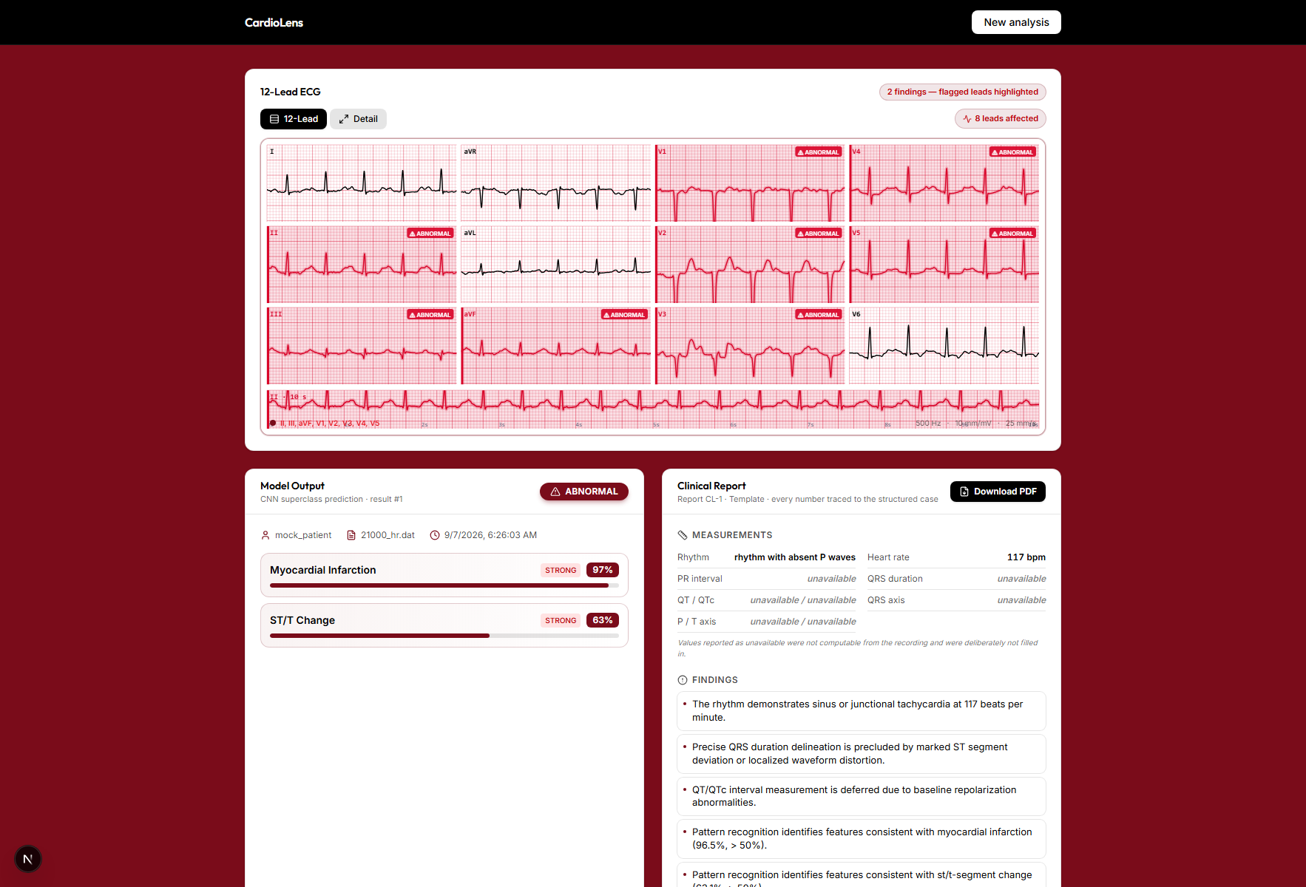
Clinician-Centric Dashboard
Intuitive Navigation: Designed for medical professionals with minimal training overhead.
Instant Results: Upload an ECG trace and receive classification metrics within seconds.
Export & Share: Download the one-page PDF report straight from the results card.
Analysis History: Past results are stored in SQLite and reloadable with one click.

Slide 8

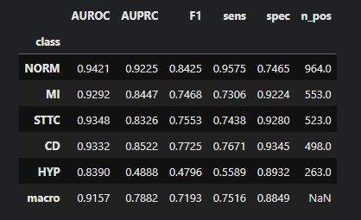
Performance & Impact
Built for Speed and Precision
21k
Our platform drastically cuts down manual sorting time, enabling faster triage in busy clinical environments.
By automating the heavy lifting of pattern recognition, healthcare providers can dedicate more time to direct patient care and critical intervention decisions.
PTB-XL TRAINING RECORDS
Model Results for Each Class

Slide 9
Development & Roadmap
From hackathon prototype to scalable healthcare solution.

Slide 10




Project Milestones
Data Prep
Model Training
App Integration
Future Scale
Dataset acquisition, noise filtration, and preprocessing pipelines.
Training classifiers and optimizing metrics for high sensitivity.
Building the report generation framework and web interface.
EHR integration, wearable streaming, and clinical pilot testing.

Slide 11
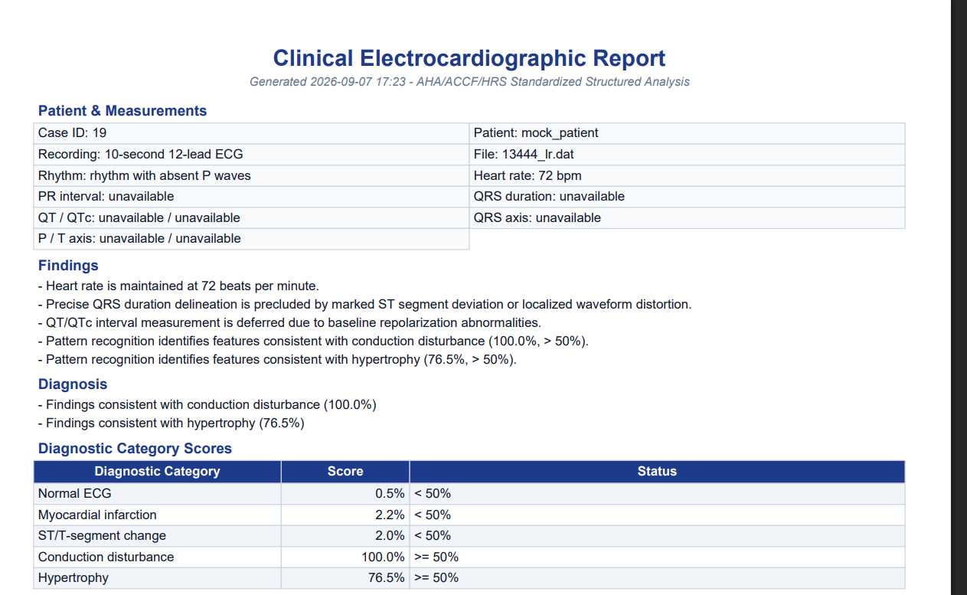
The Future Vision
Hospital System Integration: Seamlessly plug into existing Electronic Health Record (EHR) networks.
Real-time Monitoring: Expand support for wearable ECG streaming devices.
Finer-Grained Diagnoses: Extend beyond the five superclasses toward detailed PTB-XL findings.
Open Source Contribution: Empowering global researchers with transparent, accessible cardiac tools.

Slide 12
Thank You!
Ready to revolutionize cardiac diagnostics together. Questions & Feedback?
https://github.com/Hiba-Rafique/ECG-Classification-Report-Platform

